Slide 1

Starlight Starbright

Slide 2
The Elevator Song

Slide 3
The Itsy Bitsy Spider

Slide 4
Johnny Two-Notes

Slide 5
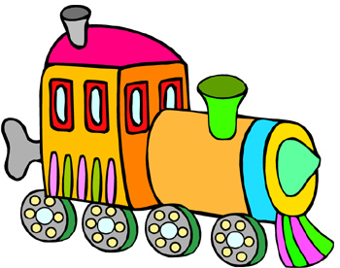
Engine, Engine Number 9
9

Slide 6
Two Little Blackbirds

Slide 7
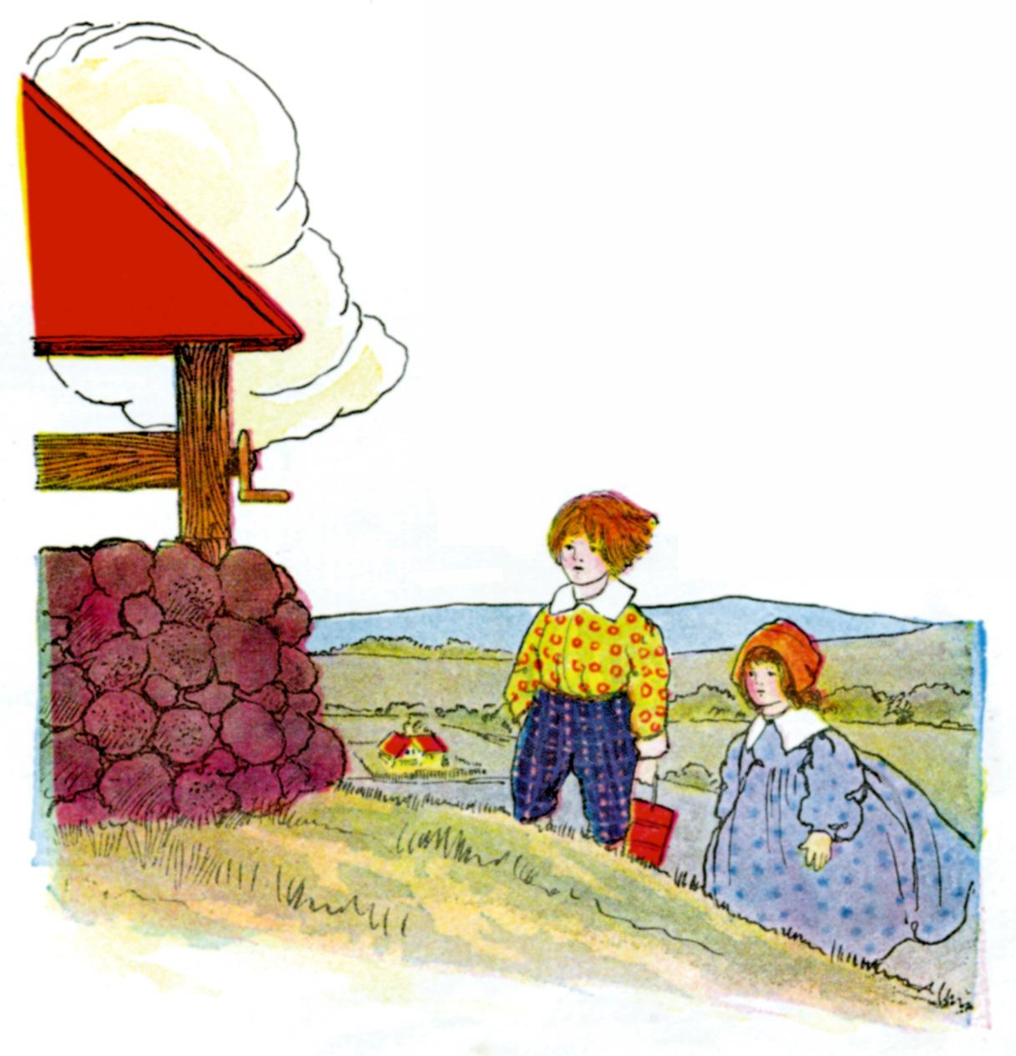
Jack and Jill

Slide 8

Baa Baa Black Sheep

Slide 9
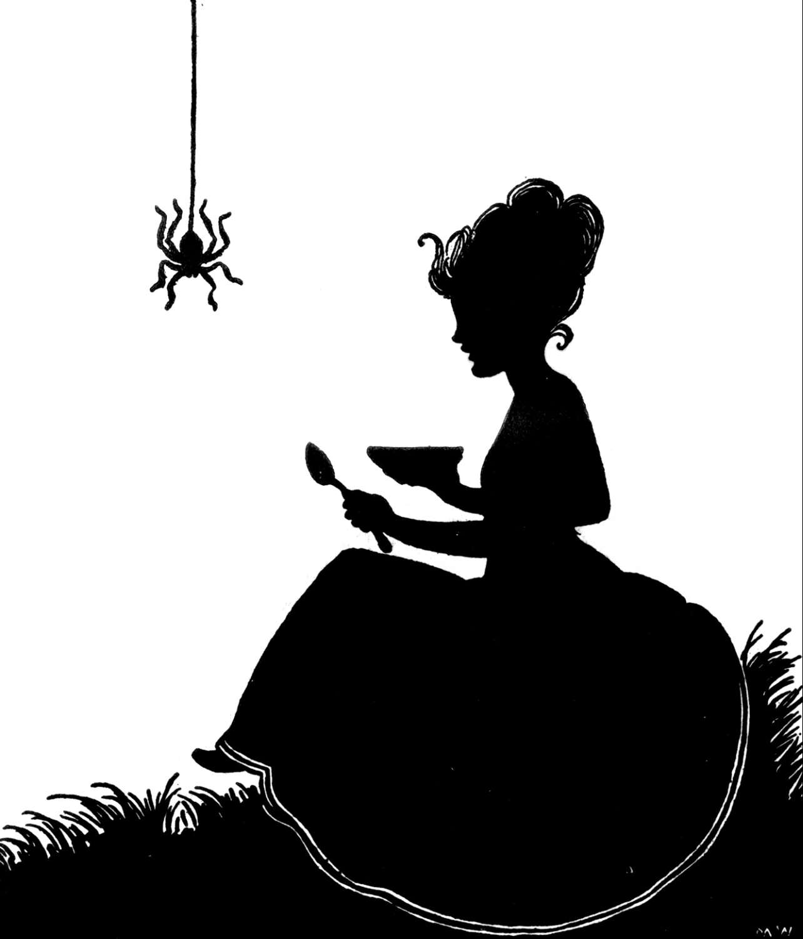
Little Miss Muffett

Slide 10
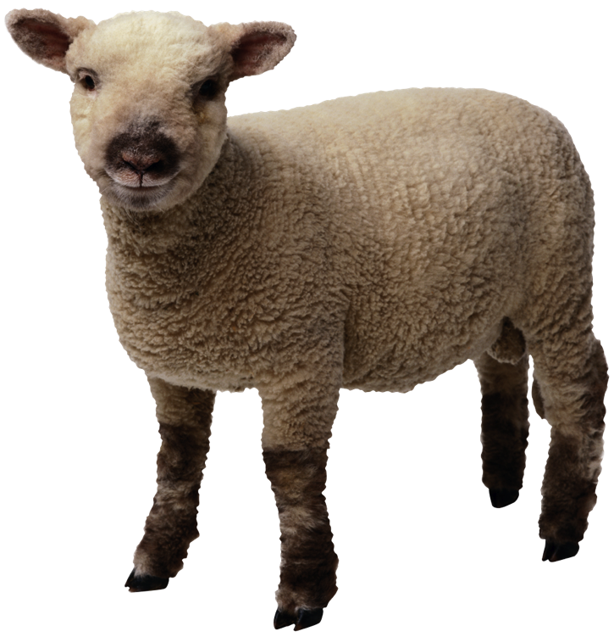
Mary Had a Little Lamb

Slide 11
Row, Row, Row Your Boat

Slide 12
1-2-3-4-5, Once I Caught a Fish Alive

Slide 13
Clap, Clap, Clap Your Hands

Slide 14
Goin’ on a Picnic

