Slide 1
Time for Music

Slide 2
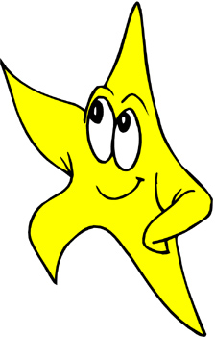
Starlight Starbright

Slide 3
The Elevator Song

Slide 4
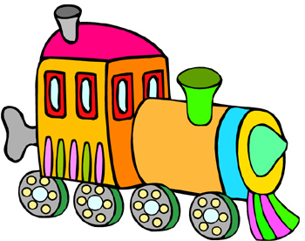
Engine, Engine Number 9
9

Slide 5
The Itsy Bitsy Spider

Slide 6
1-2-3-4-5, Once I Caught a Fish Alive

Slide 7
Bluebird Bluebird

Slide 8
The Sun is Rising

Slide 9
Teddy Bear Teddy Bear

Slide 10

Baa Baa Black Sheep

Slide 11
Black Snake

Slide 12
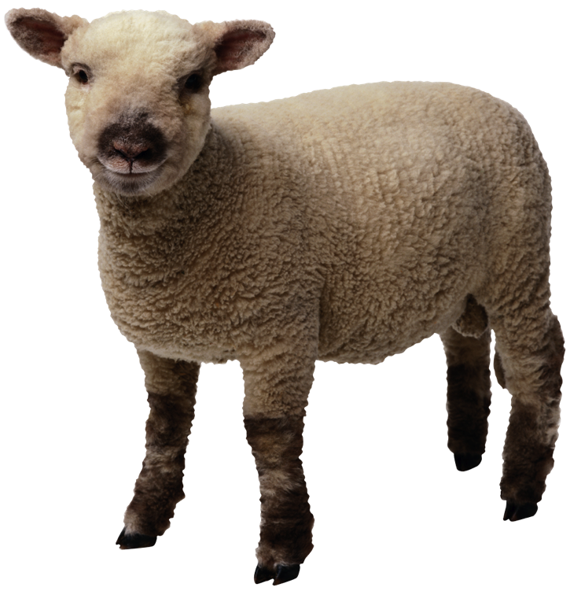
Mary Had a Little Lamb

Slide 13
Hush Little Baby

Slide 14
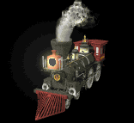
I’ve Been Workin’ on the Railroad

Slide 15
Goin’ on a Picnic

Slide 16


No More Pie

